Slide 1

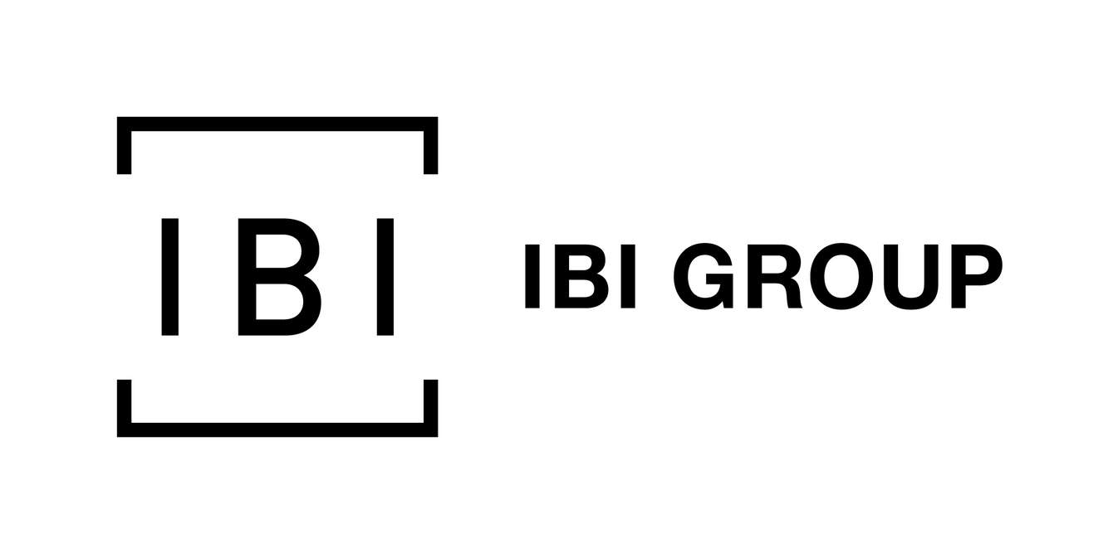
Go, change the world
RV College of
Engineering
IoT Based Smart Parking System
Name: Ujjwal
Year of study : 2021
Department : Civil Engineering
USN: 1RV18CV118

Slide 2
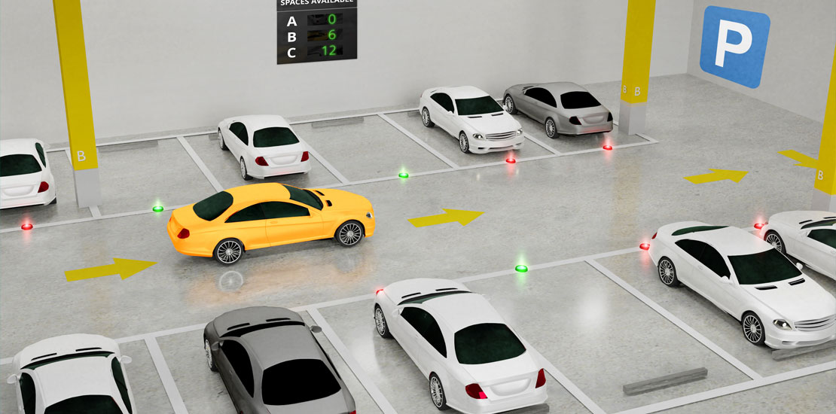
OUTLINE
INTRODUCTION
PROBLEM DEFNITION
SYSTEM METHODOLOGY
PROPOSED SYSTEM
MAIN COMPONENTS
WORKING
ADVANTAGES
APPLICATION
CONCLUSION
REFLECTION

Slide 3
INTRODUCTION
Internet of thing (IoT) has the ability to transfer data through network without involving human interactions. IoT allows user to use affordable wireless technology and also helps the user to transfer the data into the cloud.
These devices can be controlled or monitored through computers over internet.
The goal of the Smart Parking System is to reserve the slot for parking when we are at home or about to reach the location.
One of the most concerning problem that the driver faces is finding a free parking spot that leads to the parking at the edges of the roads.
Smart parking system is a solution to this kind of problem

Slide 4
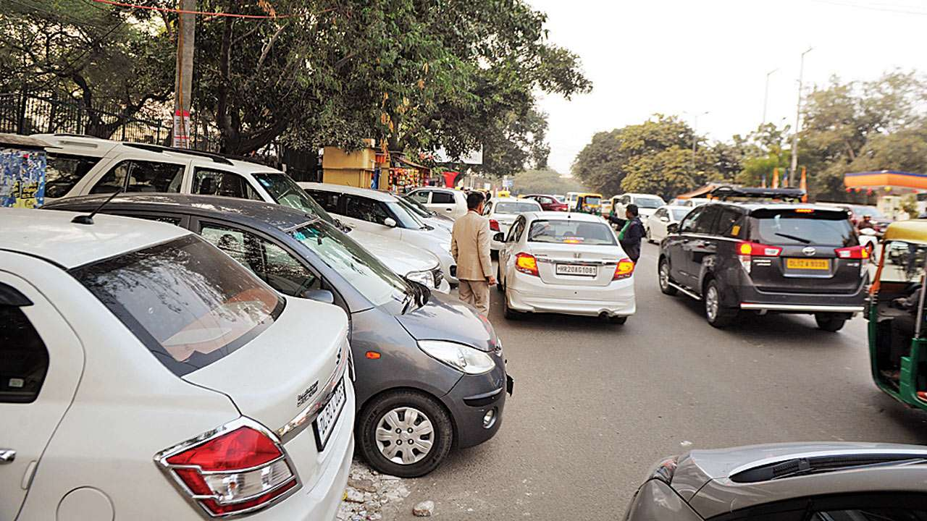
Problem Definintion
Exponential population growth leading to traffic congestion.
Violation of parking rules
Wastage of fuel in finding free parking slot
Air pollution
Unsureness and frustration among drivers

Slide 5
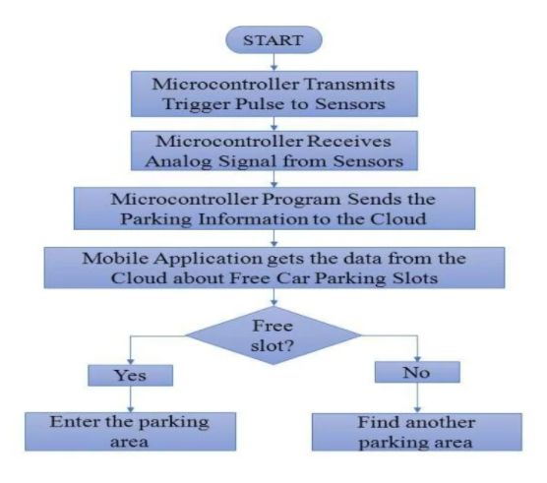
System methodology and flowchart

Slide 6
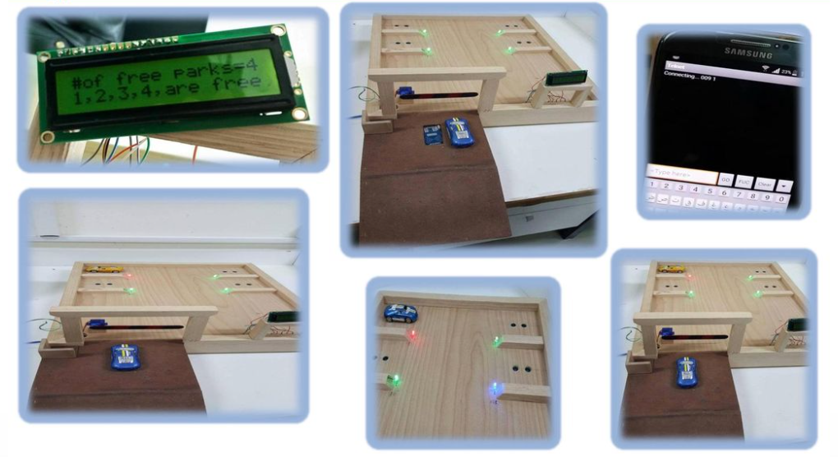
PROPOSED SYSTEM

Slide 7
MAIN COMPONENTS
Hardware
Software
RFID Card
GSM module
WiFi module
Arduino Uno
IR Sensor
Servo Motor
LED Lights
LCD Display
Web Application
Arduino IDE

Slide 8
WORKING
Automatic gate opening and closing
LCD display for driver convenience
LED light indication for empty or closed slot
Automatic scanning and verification before exit
Web application for parking area status

Slide 9
Advantages
Shorter waiting time at parking place
It saves fuel, money and space
Reduced pollution
Reduced traffic
Carbon emission is reduced
Efficiency

Slide 10
Application
Shopping malls
Restaurents
Theatre
IT firms
Hospitals etc.

Slide 11
CONCLUSION
The concept of smart cities have always been a dream. There have been advancements done in the couple of years to make smart city dream to reality. The advancement of internet of things and cloud technologies has given rise to the new possibilities in terms of smart cities. The system provides a real time process and information of parking slot. It helps to solve many growing traffic problem.

Slide 12
Reflection
Python : It is an interpreted high-level general-purpose programming language. Its design philosophy emphasizes code readability with its use of significant indentation. Its language constructs as well as its object-oriented approach aim to help programmers write clear, logical code for small and large-scale projects.
BigData : Big data is a field that treats ways to analyze, systematically extract information from, or otherwise deal with data sets that are too large or complex to be dealt with by traditional data-processing application software.
IoT : The Internet of things describes physical objects that are embedded with sensors, processing ability, software, and other technologies that connect and exchange data with other devices and systems over the Internet or other communications networks.

Slide 13
Thank You

